Slide 1
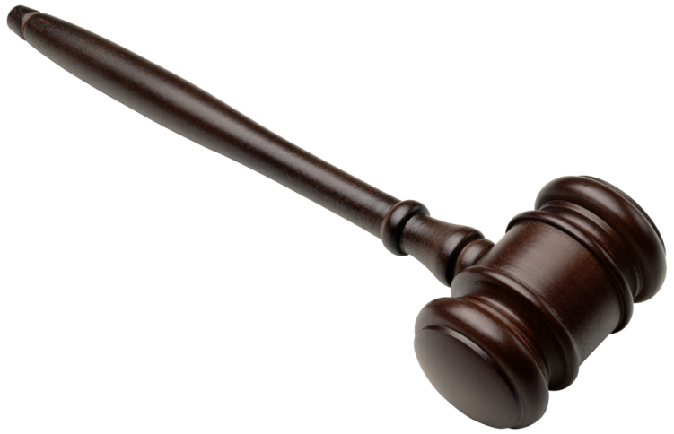
The Final Four of Everything: The Supreme Court
By Adam Liptak

Slide 2
The purpose of this tournament is to pit the top Supreme Court cases (in terms of impact on society) against each other

Slide 3
Matchups in the Round of 32

Slide 4
The way the bracket works:
For the purposes of this presentation (mainly due to efficiency purposes) the winners of the round of 32 will be automatically given
In the following rounds, each match will be discussed prior to determining the case which continues to the next round
These matches will begin with an overview of each case, followed by a brief period for class discussion, and conclude with the announcement of which case advances

Slide 5
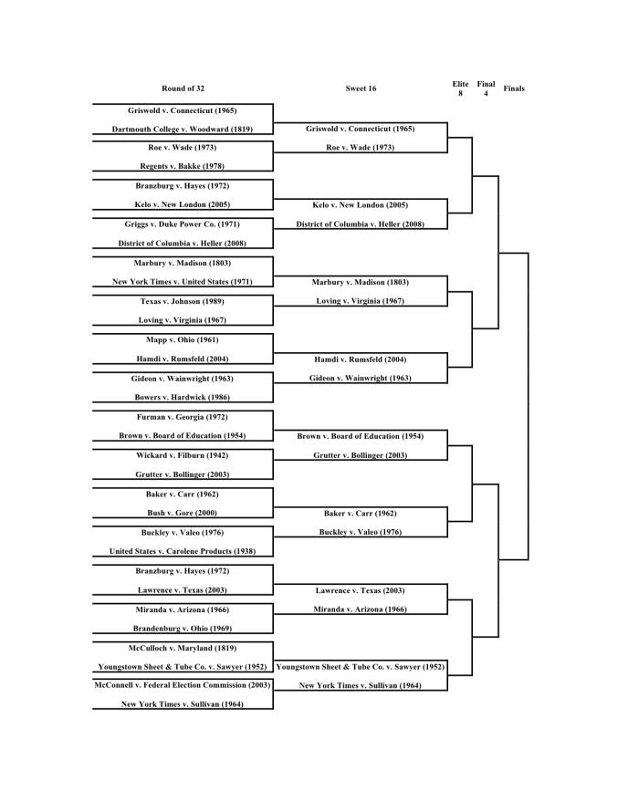
Sweet 16

Slide 6
Match 1

Slide 7
Griswold v. Connecticut (1965)
Ruling
  The Connecticut law, criminalizing the use of contraception, violated the marital right to privacy
Impact
  Contraception became legal
  Articulating a right to privacy in the constitution (something not explicitly given in the Bill of Rights)

Slide 8
Roe v. Wade (1973)
Ruling
  The Texas law making it a crime to assist a woman to get an abortion violates her due process rights
Impact
  All state laws outlawing or restricting abortion that were inconsistent with the decision were overturned
  The case built upon privacy rights articulated in Griswold v. Connecticut (1965)
  The case prompted a heated national debate

Slide 9
Winner: Roe v. Wade

Slide 10
Match 2

Slide 11
Kelo v. New London (2005)
Ruling
  The governmental transfer of property from one private citizen to another for economic development purposes is permissible under the Fifth Amendment “public use” requirement
Impact
  The government can redistribute land if it proves that it will lead to larger economic prosperity (e.g. it will create more jobs)
  A large social debate concerning property rights
  Numerous states passed more restrictive “takings” laws

Slide 12
District of Columbia v. Heller (2008)
Ruling
  The Second Amendment guarantees an individual's right to possess a firearm unconnected with service in a militia, and to use that arm for traditionally lawful purposes, such as self-defense within the home
Impact
  It articulated an individual constitutional right to own and use firearms (unconnected with the state militia)
  Heller was limited to congresses ability to regulate firearms, but the court later expanded this holding to limit state and municipal regulation of firearms

Slide 13
Winner: District of Columbia v. Heller (2008)

Slide 14
Match 3

Slide 15
Marbury v. Madison (1803)
Ruling
  The judiciary may review laws passed by Congress and actions of the executive branch to ensure they comply with the Constitution
  If a law or executive action conflicts with the Constitution, the court may strike it down
Impact
  The creation of the judicial review process in the United States
  This was a radical idea at the time, as it places the Court at the center of constitutional interpretation

Slide 16
Loving v. Virginia (1967)
Ruling
  The Court declared Virginia's anti-miscegenation statute (a law stating that people of different races could not marry)unconstitutional
Impact
  It put an end to all race based legal restrictions on marriage in the United States
  It started to articulate the concept that the state can not give effect to private racial prejudices
  It struck a massive blow to white supremacy

Slide 17
Winner: Marbury v. Madison (1803)

Slide 18
Match 4

Slide 19
Hamdi v. Rumsfeld (2004)
Ruling
  A U.S. citizen accused of being an enemy combatant has a right to due process of law
  While he does not necessarily have all rights that a criminal defendant would have, he has the right (at the very least) to notice of the charges against him, the right to respond, and the right to be represented by an attorney
Impact
  Rejected government’s assertion that it could hold U.S. citizens indefinitely as enemy combatants without trial

Slide 20
Gideon v. Wainwright (1963)
Ruling
  The Sixth Amendment right to counsel is a fundamental right applied to the states via the Fourteenth Amendment's due process clause
  The Sixth Amendment requires that indigent criminal defendants be provided counsel at trial
Impact
  Poor people accused of serious crimes are entitled to a lawyer paid for by the state
    The birth of the public defender system
  Adding a measure of “fairness”, or reduction of economic disparity, to the U.S. judicial system

Slide 21
Winner: Hamdi v. Rumsfeld (2004)

Slide 22
Match 5

Slide 23
Brown v. Board of Education (1954)
Ruling
  Racial segregation of students in public schools violates the Equal Protection Clause of the Fourteenth Amendment, because separate facilities are inherently unequal
Impact
  The reversal of the state-sponsored segregation caused by Plessy v. Ferguson (1896) (holding that separate facilities are constitutional as long as they are equal in quality)
  The beginning of integration in schools and, on a larger plane, the bedrock of the civil rights movement
  Later, in attempting to implement desegregation, courts adopted school bussing, which caused serious social unrest

Slide 24
Grutter v. Bollinger (2003)
Ruling
  University of Michigan Law School admissions program that gave special consideration for being in certain racial minorities did not violate the Fourteenth Amendment
  Diversity (at least in education) is a compelling justification for using affirmative action
Impact
  Certain types of affirmative action programs were held to be permissible
  Diversity, as well as remedying past discrimination, was permitted as a justification for affirmative action in education

Slide 25
Winner: Brown v. Board of Education (1954)

Slide 26
Match 6

Slide 27
Baker v. Carr (1962)
Ruling
  The redistricting of state legislative districts is not a “political question”, and thus is justiciable by the federal courts
Impact
  Federal courts became involved in the reapportionment process, as they can intervene and decide in cases regarding state legislative districts
  Articulated a set of factors to distinguish non-justiciable “political questions” from cases subject to judicial review

Slide 28
Buckley v. Valeo (1976)
Ruling
  The Court held that giving money to political campaigns is a form of speech protected by the First Amendment
  Held that limits on campaign contributions are permissible only to prevent corruption and appearance of corruption
  Upheld law requiring disclosure of campaign contributions
Impact
  Precludes most types of campaign finance regulations as violative of First Amendment’s free speech guarantee
  Permits disclosure requirements

Slide 29
Winner: Baker v. Carr (1962)

Slide 30
Match 7

Slide 31
Lawrence v. Texas (2003)
Ruling
  A Texas law criminalizing consensual adult homosexual intercourse violated liberty interests protected by the Fourteenth Amendment
Impact
  Arguably protects right to engage in private, adult, consensual sexual relations.
  Overturned previous precedent of Bowers v. Hardwick (1986), which held that states could criminalize same-sex sexuality
  A massive win for the gay rights movement and it created hope that subsequent wins (including, possibly, mandatory recognition of gay marriage) could be possible

Slide 32
Miranda v. Arizona (1966)
Ruling
  The Fifth Amendment privilege against self-incrimination requires law enforcement officials to advise a suspect interrogated in custody of his rights to remain silent and to obtain an attorney
Impact
  Statements made by a defendant in police custody under interrogation may only be used in court if the defendant has been made aware of his right to remain silent and to obtain an attorney prior to interrogation
  Beginning of the formal warning, “the right to remain silent and to obtain an attorney”, given by police officers in the U.S.
  Raised question of proper remedy for failure to provide warnings, including exclusion of otherwise relevant evidence (the “Exclusionary Rule”)

Slide 33
Winner: Miranda v. Arizona (1966)

Slide 34
Match 8

Slide 35
Youngstown Sheet & Tube Co. v. Sawyer (1952)
Holding
  The President did not have the inherent authority to seize private property, even as part of a war effort, at least where Congress seems to have prohibited the act in question.
Impact
  It limited the President’s authority to act without clear constitutional authority, at least contrary to Congress’s will
  One of the few times the Court has stood up to the President during war

Slide 36
New York Times v. Sullivan (1964)
Ruling
  The First Amendment protected a newspaper from being sued for libel in state court for making false defamatory statements about the official conduct of a public official, because the statements were not made with knowing or reckless disregard for the truth
Impact
  Extension of First Amendment “free speech” rights, in this specific instance for newspapers
  Proof of falsity is not enough to punish a speaker who was discussing matters of public concern (in this case, journalists). Someone hurt by the speech must also prove an additional element: “reckless disregard”

Slide 37
Winner: Youngstown Sheet & Tube Co. v. Sawyer (1952)

Slide 38
Elite 8

Slide 39
Quarterfinals Game 1

Slide 40
Winner: Roe v. Wade (1973)

Slide 41
Quarterfinals Game 2

Slide 42
Winner: Marbury v. Madison (1803)

Slide 43
Quarterfinals Game 3

Slide 44
Winner: Brown v. Board of Education (1954)

Slide 45
Quarterfinals Game 4

Slide 46
Winner: Youngstown Sheet & Tube Co. v. Sawyer (1952)

Slide 47
Final 4

Slide 48
Semifinals Game 1

Slide 49
Winner: Marbury v. Madison (1803)

Slide 50
Semifinals Game 2

Slide 51
Winner: Brown v. Board of Education (1954)

Slide 52
FINALS
Marbury v. Madison (1803)
vs.
Brown v. Board of Education (1954)

Slide 53
WINNER
Brown v. Board of Education (1954)

