Slide 1
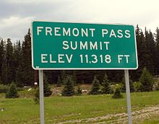
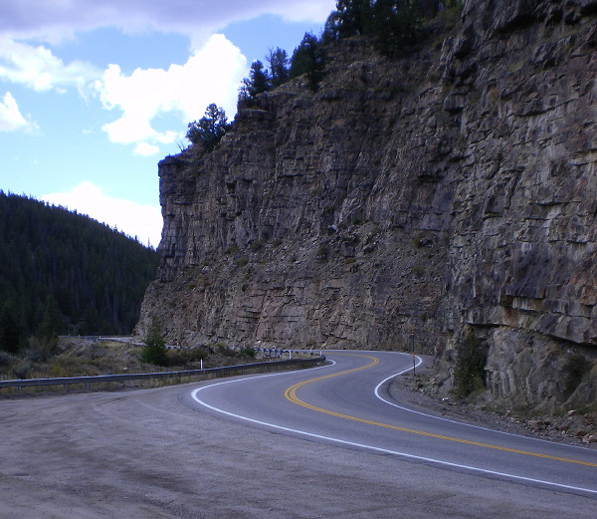
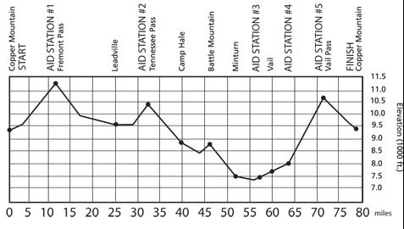
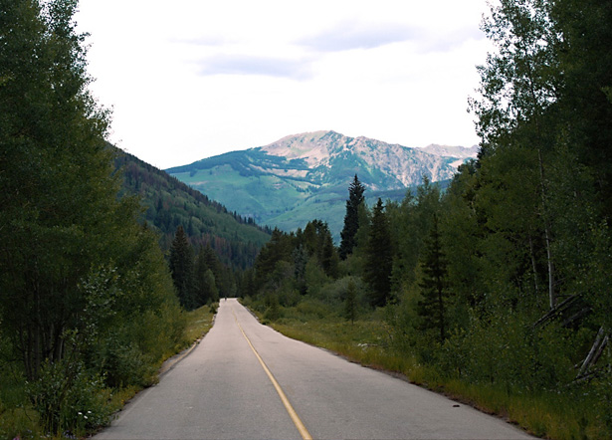
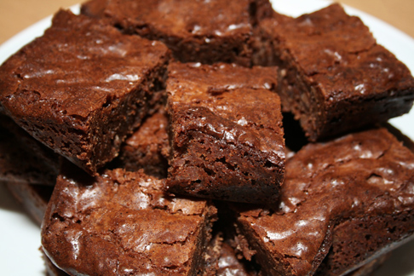

Slide 2
Where to begin?

Slide 3
Beginning Break Down
For ALL the questions you need to understand what you KNOW and DON’T KNOW about the concepts/ideas in the question.
For each question (ALL OF THEM). Make a list of the ideas/terms/concepts and then what you KNOW about it and what you don’t know about it.
I want all group members to do this.
Example (Unit 1 Question 1)
The Virginia Declaration of Rights was the first written enumeration of the rights of citizens and the fundamental principles of government in the newly independent United States. What ideas drawn from the natural rights philosophy were incorporated into the Virginia Declaration of Rights?
• What ideas drawn from classical republicanism are included in the Virginia Declaration of Rights?
• What rights that Americans enjoy today under both their state and national bills of rights were included
Idea/concept/term | KNOW | Don’t Know
Virginia Declaration of Rights Enumeration | Similar to the Declaration of Independence Talked about Natural Rights 1776 Written rights as opposed to NOT WRITTEN | Why it was written (what was going on at the time in Virginia) Who wrote it The specific rights covered in it

Slide 4
Reading /understanding/analyzing the questions
Read the questions…read…and re-read
Make sure you have a base understand of what the questions are asking. This will be enhanced with the help of your unit members and your coach. Your understanding will also increase with your research of the questions.
Use your We the People book to help begin your research!

Slide 5
Resources
I will begin to send you a number of resources to help you get started. These will include past essays. Your research will also be invaluable. I will also be putting this on our website as well.
If your question has a quote or a selection from a book or a reading, we need to find that resource and use it!
MY BOOKS!

Slide 6
SPLITTING UP THE QUESTIONS
Everyone needs to be knowledgeable of all of the questions, therefore they need to be split up
UNIT 1 QUESTION 1
1. According to the founding generation, a constitution should function as a higher law. In what important ways does a higher law differ from a statute enacted by a legislature?
• How would you distinguish between a government with a constitution and a constitutional government?
• What are the advantages and disadvantages of a written constitution?
AND REPEAT WITH OTHER TWO QUESTIONS

Slide 7
ESSAYS
Each person must write a three page essay answering one part of each of the three questions. You will write 3 essays in total!
Question #1 due: 9/15
Question #2 due: 9/29
Question #3 due :10/6
First practice 10/14

Slide 8
GOOGLE DOCS
http://docs.google.com/
Click: “Get Started” button
Fill out form:
Your current email address: Use your personal email
Choose a password: Whatever you can remember easily
Creating a document.
Go to new and open a new document. You can either type in this field or cut and paste a document in.
Uploading a document
Go to upload a document and browse the documents to add onto the page.
Sharing a Document
Once you have placed a document on Google Docs, click SHARE and add the email addresses of those you wish to see the document.
Add me, your coach, your team members!

Slide 9
UNIT MEETINGS
3 per week
2 with your unit, 1 with your coach
Agenda
Discussion of questions and what they are asking/splitting them up
discussing resources/findings/information
Getting advice and information from coaches
Reading/discussing essays/revisions
Etc!

Slide 10
REMIND 101

Slide 11
WEBSITES!
http://www.facebook.com/pages/Northglenn-We-The-People/213583278672948
This has a video from our UNIT 1 that beat East at state two years ago!
http://new.civiced.org/programs/we-the-people/simulated-congressional-hearings-2010
National Finals videos!

Slide 12
TSHIRTS
You design!
In the past students have used customink.com and sent me the designs and we discussed them as a class.
http://www.customink.com/
You may use another site if you wish!

Slide 13
AFTER 1st PRACTICE
What went well?
What do you need to improve on? HOW?
BEGIN YOUR EDITING! (FRIDAY)
Next opening by next practice. Which question?

